Slide 1

Comparison between SQL and NoSQL databases & Analytical model building for database suggestion
Presented by
Yashkumar Trada (30147101)
Anish Mukherjee
Harsh Mishra
October 2022

Slide 2




SQL vs NoSQL

Slide 3
Project Statement: Will perform the different types of same operations (Like select, search, delete, update, join, group by, etc.) on both SQL and NoSQL databases and note the query execution time. Also, measure the resilience and performance impact of scaling up the data to a reasonable threshold limit. Finally, based on the measured time for each query execution and noted the performance impact, will build an analytical, which takes user requirement as input and suggest the most appropriate database.

Slide 4
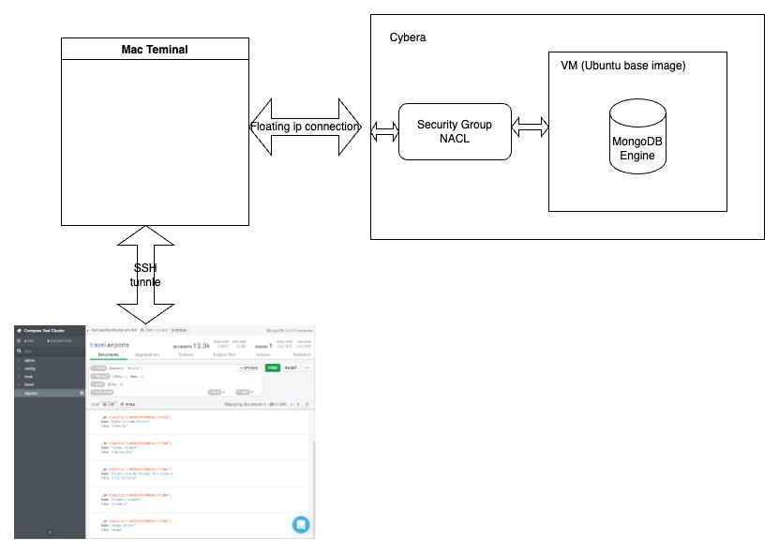
System Architecture (MongoDB):

Slide 5
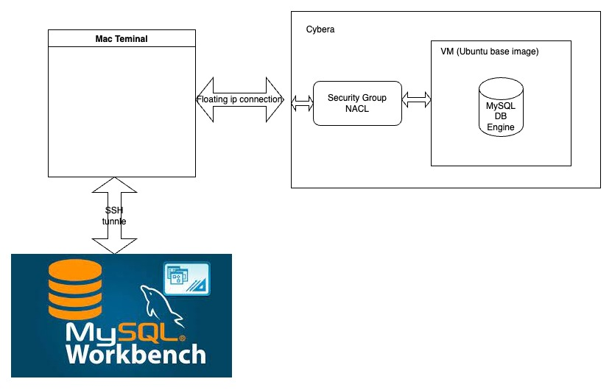
System Architecture (MySQL server):

Slide 6
Operations performance to be measured:
Insert
Delete based on conditions
Update based on conditions
Search by regular expression
Join
Rank by
Partition by
Group by
Other aggregate operations

Slide 7
Performance Metrics:
Execution time
Throughput
Resource utilization (Memory, CPU and Disk) Monitorix – Linux system and Network Monitoring tool
Important Factors:
Size of dataset
Number Virtual CPUs
Memory allocation
Query type (Insert, Delete, Update, Search Join etc.)
Indexing
Cache
Datatype of field

Slide 8
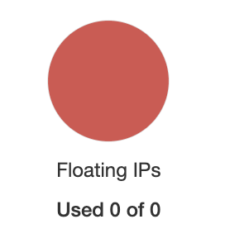
Difficulties Encountered:
1. No floating Ip provided by Cybera
2. Launching multiple VMs from multiple Cybera account for complete isolation between different DB engines.
3. Finding a right size of dataset for the given size of instance available in cybera.
4. Defining the schema for the MySQL. (Needed to clean the data and convert into a compatible format).
5. Normal TEXT field type in MySQL has a character limit and we have very long text in reviews column. Found a Medium TEXT & LARGETEXT data type to store this field data.
6. The dataset server is down from last few days. So, needed to find a way to extract dataset from VM launched in Cybera.
dataset link: http://deepyeti.ucsd.edu/jianmo/amazon/categoryFiles/Video_Games.json.gz
7. Unable to load dataset in Casandra using JSON file.

Slide 9
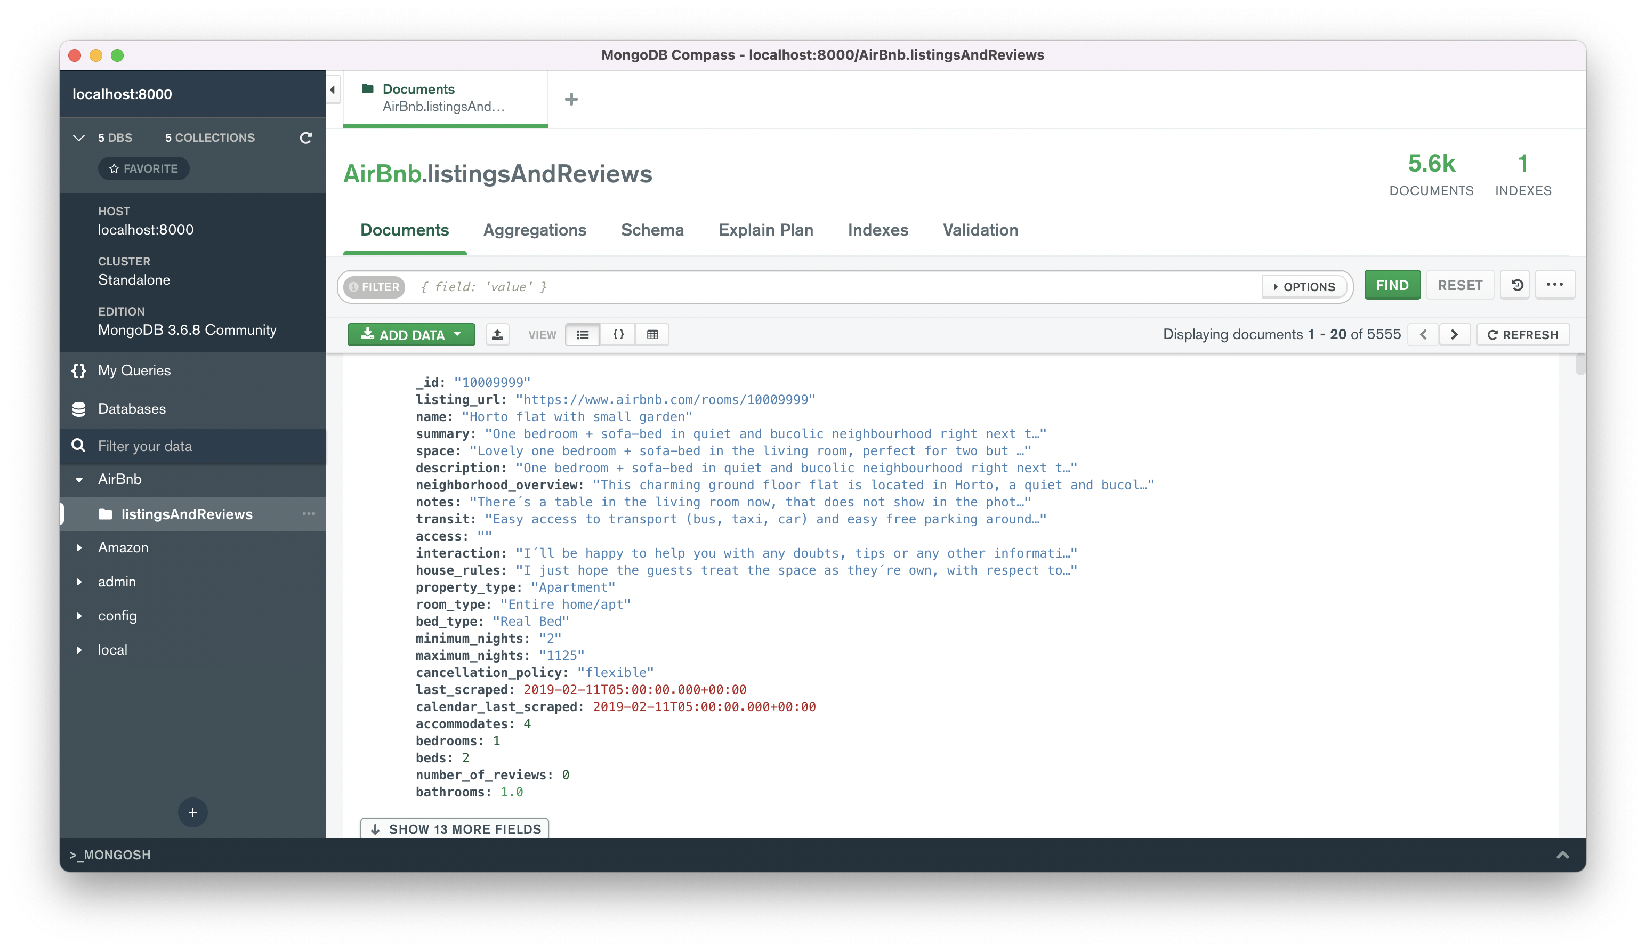

Slide 10
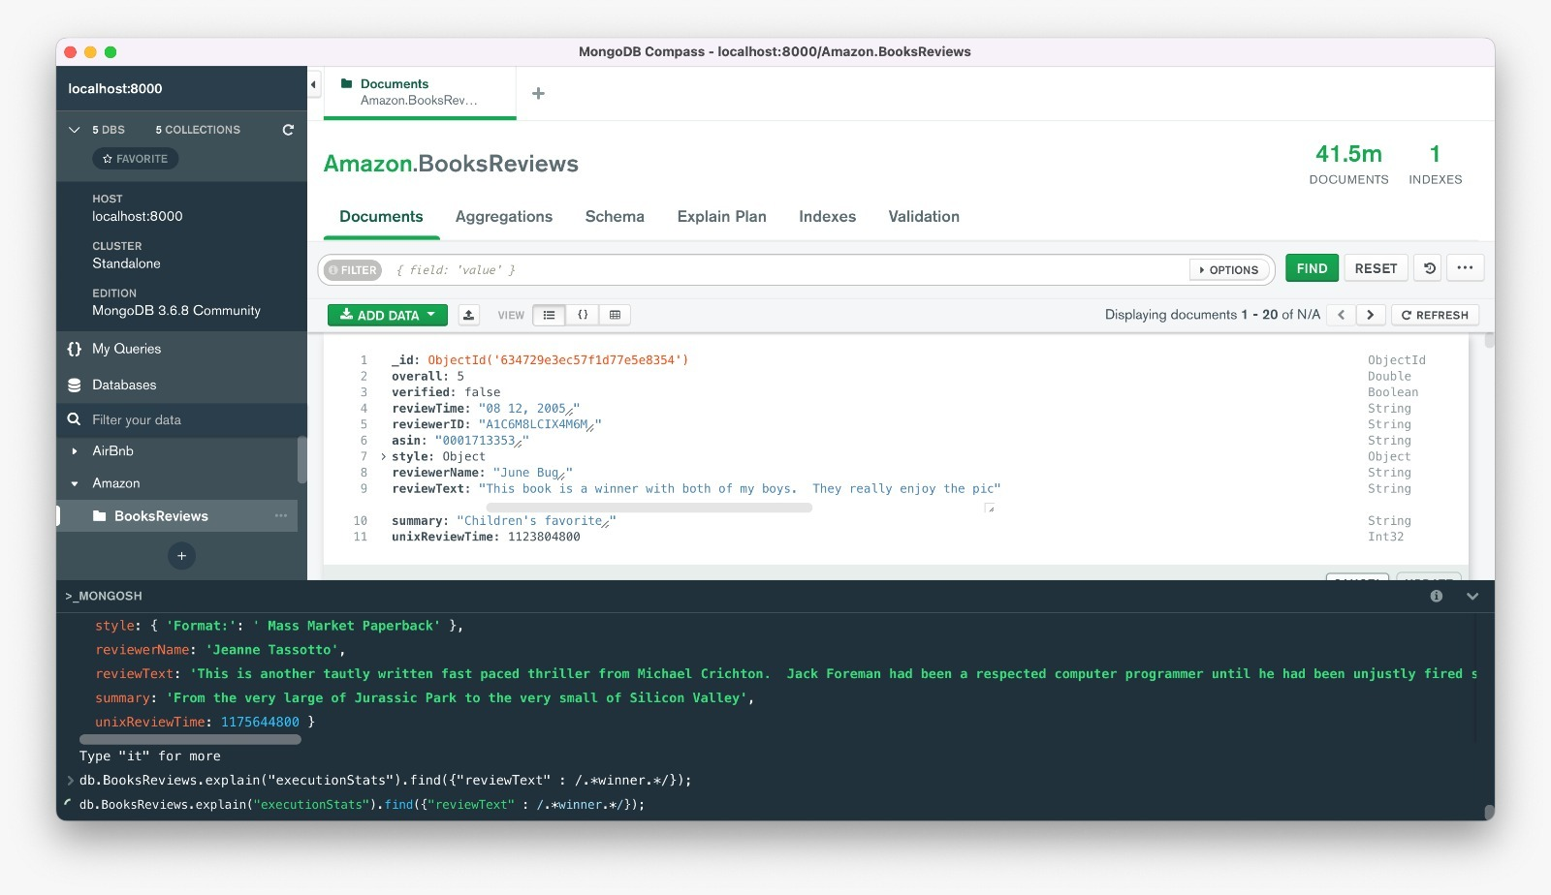

Slide 11
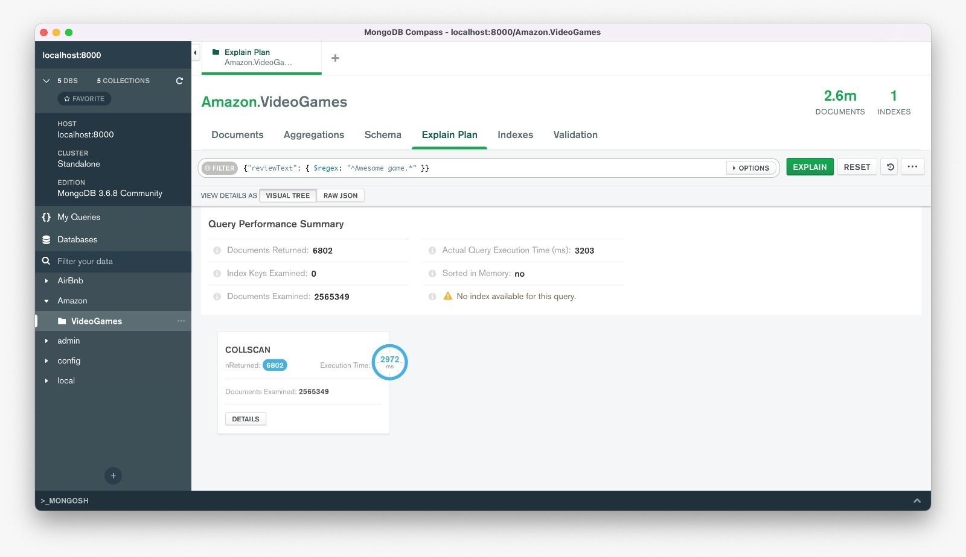

Slide 12
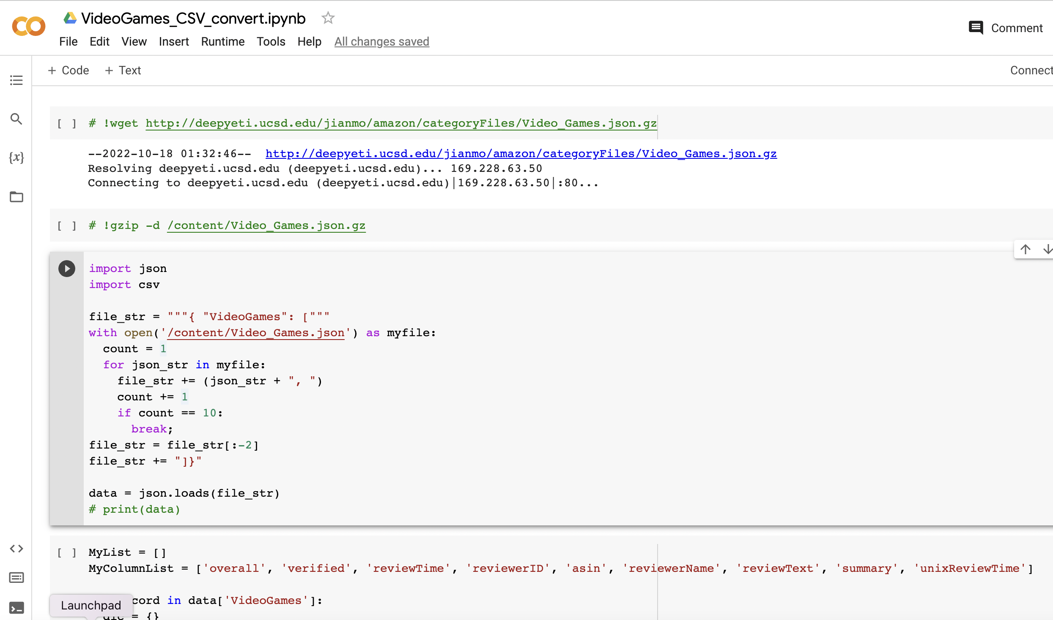
Coverting unstructed(NoSQL) dataset into structured(SQL) dataset:
https://colab.research.google.com/drive/1kekEuQFUKmpdEdT5jbNcgQq7j5d-dMFV?usp=sharing

Slide 13
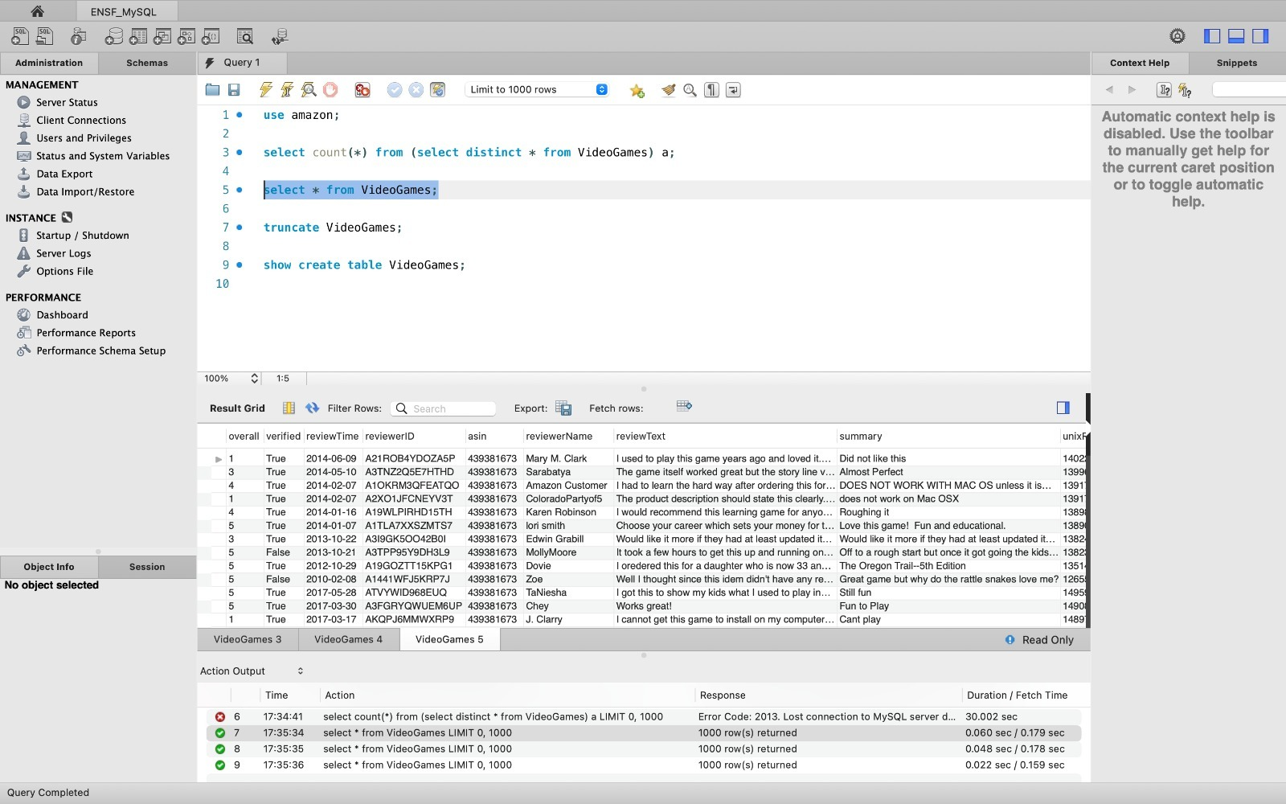

Slide 14
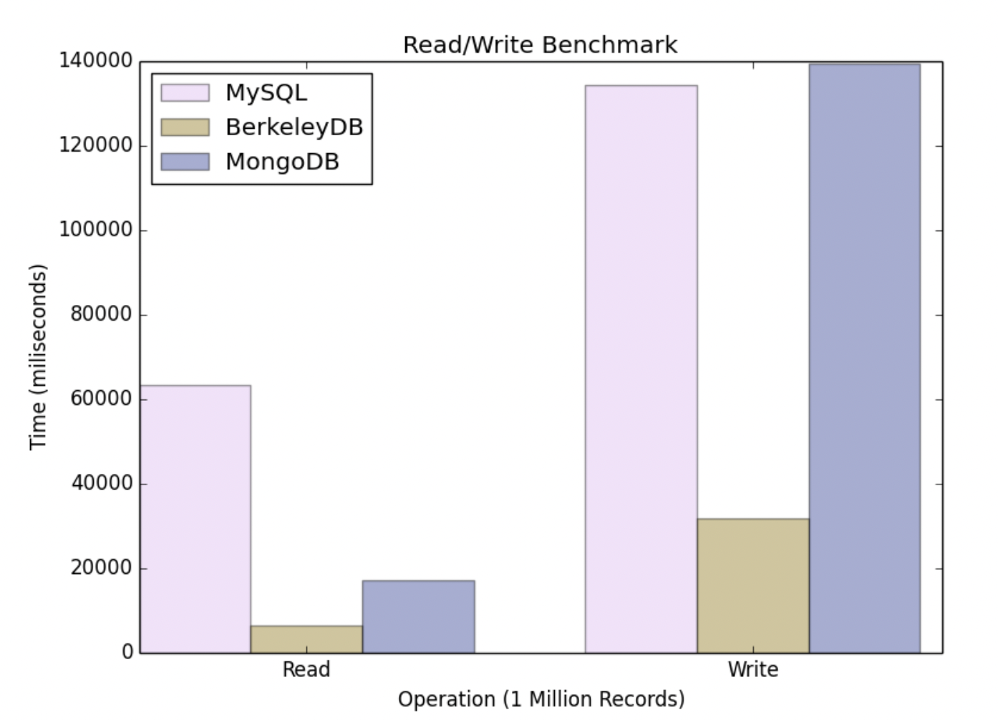
Relevant work:
SQL vs NoSQL: A Performance Comparison
Ruihan Wang, Zongyan Yang from University of Rochester

Slide 15
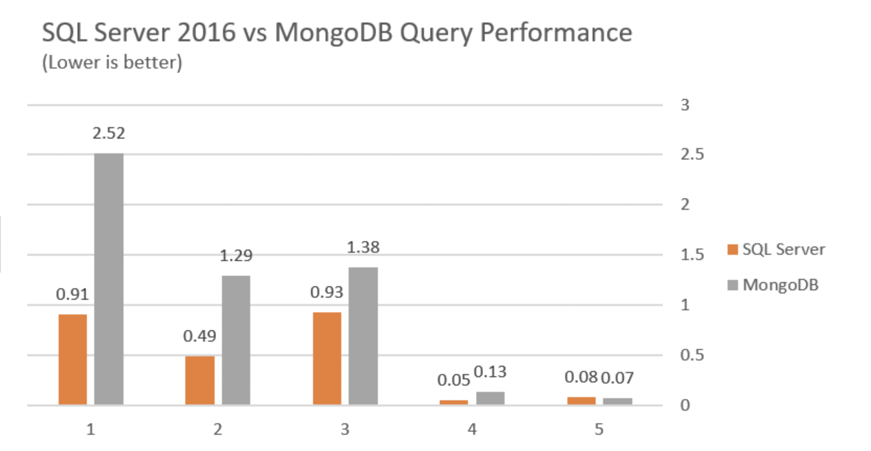
Relevant work:
Retrieve the whole 100K records
Query by a date range
Query by a single parameter
Query by 4 parameters
Query by nested property of the JSON

Slide 16
Final Goal:
Based on the performance measured by different database engines, we will build an analytical model, which takes user requirements in the below format and suggest the most appropriate database for the application.
Expected number of read, write, delete, insert operations
Expected number of joins, group by, partition by and other aggregate operations
Estimated dataset size
Properties to be maintained during operations (Like Atomicity, Consistency, Isolation, Durability, Availability, or Partition Tolerance).

Slide 17




Expansion of project scope if required:
Add more types of other database engines in our experiments:

Slide 18
References:
https://www.cs.rochester.edu/courses/261/fall2017/termpaper/submissions/06/Paper.pdf
https://www.researchgate.net/publication/339883071_SQL_vs_NoSQL
https://ils.unc.edu/courses/2018_fall/inls523_004/nosql.pdf
https://www.tecmint.com/command-line-tools-to-monitor-linux-performance/
https://www.oracle.com/a/ocom/docs/database/kuppingercole-sql-vs-nosql-report.pdf
https://memilavi.com/2018/08/15/mongodb-vs-sql-server-2016-performance/

Slide 19
Based on the Feedback
Cut down the scope. Kept only MySQL vs NoSQL (MongoDB). Because writing the same queries in MongoDB seems much more difficult.
Project architecture was already set up in during the assignment 1.
Written around 50 queries covers almost all the possible types of database operations.
So, at the end we could build a model to suggest the right kind of database for the require operations.

Slide 20
Observations:
Finding similar type of MySQL equivalent function in MongoDB is not easy. So, need to write in in the some other manner to generate the output. (Example number of words, 1- count the spaces or replace the space with empty string then count the length difference).
MySQL DB has very good caching property. So, might lead us to misleading conclusion. To avoid this, we are thinking to take the average approach.

